Slide 1
Chapter 4
Control Structures I (Selection)

Slide 2
Objectives (1 of 1)
In this chapter, you will:
  Learn about control structures
  Examine relational operators
  Discover how to use the selection control structures if, if…else
  Examine int and bool data types and logical (Boolean) expressions
  Examine logical operators
  Explore how to form and evaluate logical (Boolean) expressions

Slide 3
Control Structures (1 of 2)
A computer can proceed:
  In sequence
  Selectively (branch): making a choice
  Repetitively: looping
  By calling a function
The two most common control structures are:
  Selection
  Repetition

Slide 4
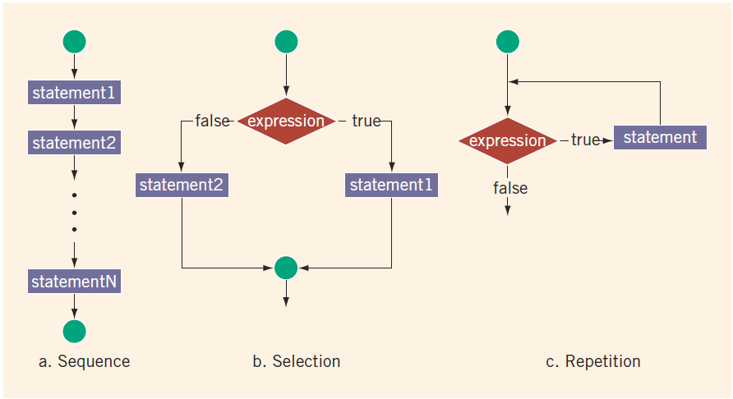
Control Structures (2 of 2)
FIGURE 4-1 Flow of execution

Slide 5
Selection: if and if...else
An expression that evaluates to true or false is called a logical expression
  “8 is greater than 3” is true

Slide 6
Relational Operators
TABLE 4-1 Relational Operators in C++
Operator | Description
== | equal to
!= | not equal to
< | less than
<= | less than or equal to
> | greater than
>= | greater than or equal to
Each relational operator is a binary operator (requires two operands)
Expressions using these operators always evaluate to true or false

Slide 7
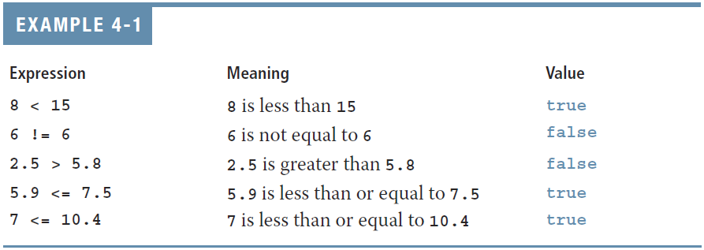
Relational Operators and Simple Data Types
You can use the relational operators with all three simple data types

Slide 8
Comparing Characters
In an expression of char values using relational operators:
  The result depends on the machine’s collating sequence
    ASCII character set
Logical (Boolean) expressions:
  Include expressions such as 4 < 6 and 'R' > 'T’
  Return an integer value of 1 if the logical expression evaluates to true
  Return an integer value of 0 otherwise

Slide 9

One-Way Selection (1 of 2)
One-way selection syntax
The statement is:
  Executed if the value of the expression is true
  Bypassed if the value is false; program goes to the next statement
The expression is also called a decision maker
The statement following the expression is also called the action statement

Slide 10
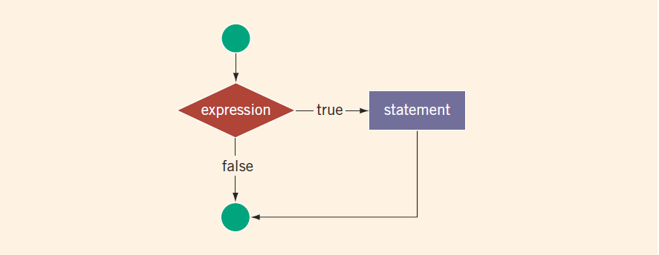
One-Way Selection (2 of 2)
FIGURE 4-2 One-way selection

Slide 11
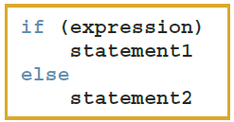
Two-Way Selection (1 of 2)
Two-way selection syntax
If expression is true, statement1 is executed; otherwise, statement2 is executed
  statement1 and statement2 are any C++ statements

Slide 12
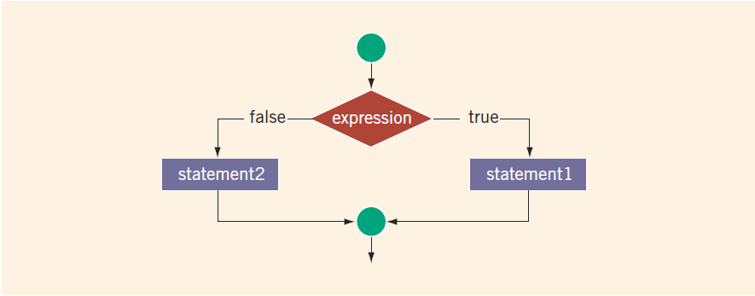
Two-Way Selection (2 of 2)
FIGURE 4-3 Two-way selection

Slide 13
int Data Type and Logical (Boolean) Expressions
Earlier versions of C++ did not provide built-in data types that had Boolean values
Logical expressions evaluate to either 1 or 0
  Logical expression value was stored in a variable of the data type int
You can use the int data type to manipulate logical (Boolean) expressions

Slide 14
bool Data Type and Logical (Boolean) Expressions
The data type bool has logical (Boolean) values true and false
bool, true, and false are reserved words
The identifier true has the value 1
The identifier false has the value 0

Slide 15
Logical (Boolean) Operators and Logical Expressions (1 of 5)
Logical (Boolean) operators enable you to combine logical expressions
TABLE 4-2 Logical (Boolean) Operators in C++
Operator | Description
! | not
&& | and
|| | or

Slide 16
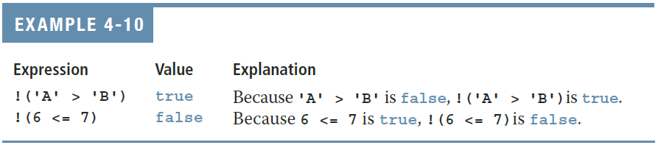
Logical (Boolean) Operators and Logical Expressions (2 of 5)
TABLE 4-3 The ! (Not) Operator
Expression | !(Expression)
true (nonzero) | false (0)
false (0) | true (1)

Slide 17
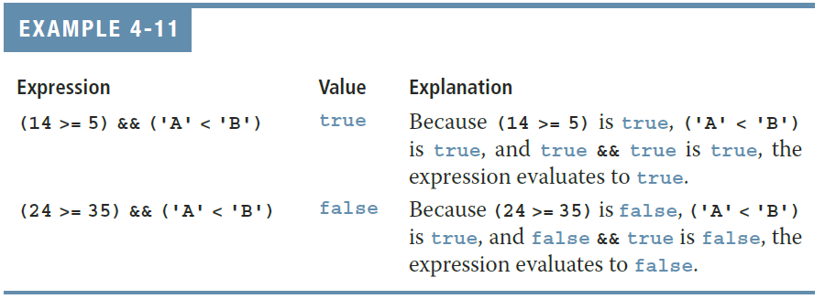
Logical (Boolean) Operators and Logical Expressions (3 of 5)
TABLE 4-4 The && (And) Operator
Expression1 | Expression2 | Expression1 && Expression2
true (nonzero) | true (nonzero) | true (1)
true (nonzero) | false (0) | false (0)
false (0) | true (nonzero) | false (0)
false (0) | false (0) | false (0)

Slide 18
Logical (Boolean) Operators and Logical Expressions (4 of 5)
TABLE 4-5 The || (Or) Operator
Expression1 | Expression2 | Expression1 || Expression2
true (nonzero) | true (nonzero) | true (1)
true (nonzero) | false (0) | true (1)
false (0) | true (nonzero) | true (1)
false (0) | false (0) | false (0)

Slide 19
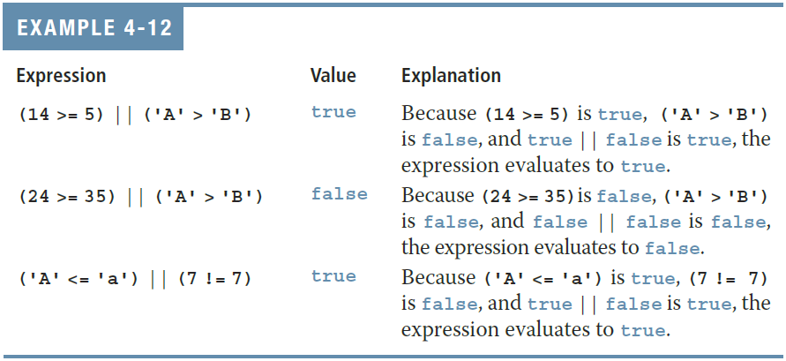
Logical (Boolean) Operators and Logical Expressions (5 of 5)

Slide 20
Order of Precedence (1 of 5)
Relational and logical operators are evaluated from left to right
  The associativity is left to right
Parentheses can override precedence

Slide 21
Order of Precedence (2 of 5)
TABLE 4-6 Precedence of Operators
Operators | Precedence
!, +, - (unary operators) | first
*, /, % | second
+, - | third
<, <=, >=, > | fourth
==, != | fifth
&& | sixth
|| | seventh
= (assignment operator) | last

Slide 22
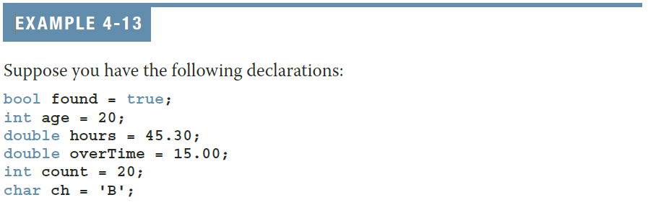
Order of Precedence (3 of 5)

Slide 23
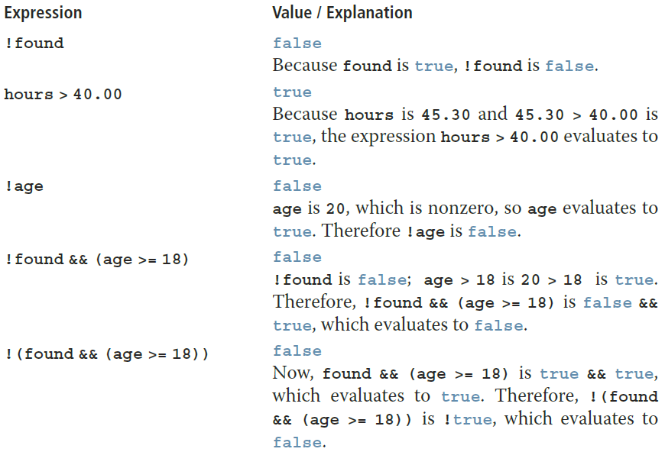
Order of Precedence (4 of 5)

Slide 24
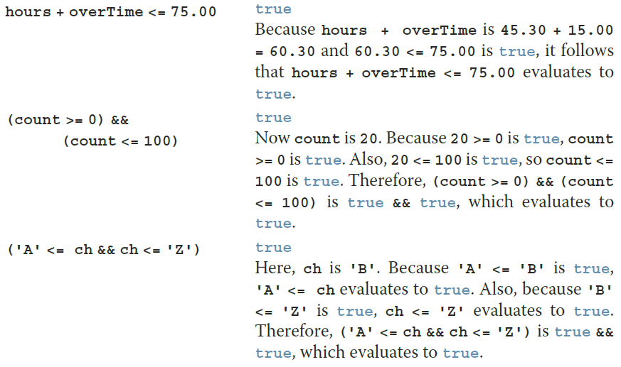
Order of Precedence (5 of 5)

Slide 25
Relational Operators and the string Type (1 of 5)
Relational operators can be applied to variables of type string
  Strings are compared character by character, starting with the first character
  Comparison continues until either a mismatch is found or all characters are found equal
  If two strings of different lengths are compared and the comparison is equal to the last character of the shorter string
    The shorter string is less than the larger string

Slide 26
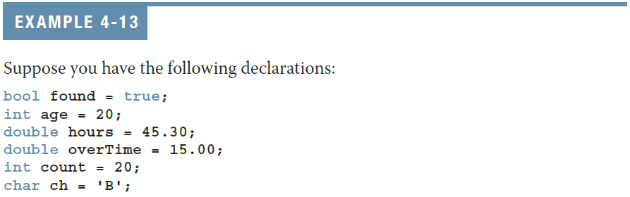
Relational Operators and the string Type (2 of 5)

Slide 27
Relational Operators and the string Type (3 of 5)
Expression | Value/Explanation
str1 < str2 | true str1 = "Hello" and str2 = "Hi". The first character of str1 and str2 are the same, but the second character 'e' of str1 is less than the second character 'i' of str2. Therefore, str1 < str2 is true.
str1 > "Hen" | false str1 = "Hello". The first two characters of str1 and "Hen" are the same, but the third character 'l' of str1 is less than the third character 'n' of "Hen". Therefore, str1 > "Hen" is false.
str3 < "An" | true str3 = "Air". The first characters of str3 and "An" are the same, but the second character 'i' of "Air" is less than the second character 'n' of "An". Therefore, str3 < "An" is true.

Slide 28
Relational Operators and the string Type (4 of 5)
Expression | Value/Explanation
str1 == "hello" | false str1 = "Hello". The first character 'H' of str1 is less than the first character 'h' of "hello" because the ASCII value of 'H' is 72, and the ASCII value of 'h' is 104. Therefore, str1 == "hello" is false.
str3 <= str4 | true str3 = "Air" and str4 = "Bill". The first character 'A' of str3 is less than the first character 'B' of str4. Therefore, str3 <= str4 is true.
str2 > str4 | true str2 = "Hi" and str4 = "Bill". The first character 'H' of str2 is greater than the first character 'B' of str4. Therefore, str2 > str4 is true.

Slide 29
Relational Operators and the string Type (5 of 5)
Expression | Value/Explanation
str4 >= "Billy" | false str4 = "Bill". It has four characters and "Billy" has five characters. Therefore, str4 is the shorter string. All four characters of str4 are the same as the corresponding first four characters of "Billy", and "Billy" is the larger string. Therefore, str4 >= "Billy" is false.
str5 <= "Bigger" | true str5 = "Big". It has three characters and "Bigger" has six characters. Therefore, str5 is the shorter string. All three characters of str5 are the same as the corresponding first three characters of "Bigger", and "Bigger" is the larger string. Therefore, str5 <= "Bigger" is true.

Slide 30
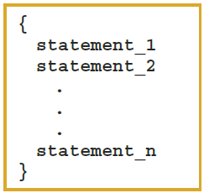
Compound (Block of) Statements (1 of 2)
A compound statement (block of statements) has this form:
A compound statement functions like a single statement

Slide 31
Compound (Block of) Statements (2 of 2)
if (age > 18)
{
cout << "Eligible to vote." << endl;
cout << "No longer a minor." << endl;
}
else
{
cout << "Not eligible to vote." << endl;
cout << "Still a minor." << endl;
}

Slide 32
Multiple Selections: Nested if (1 of 2)
When one control statement is located within another, it is said to be nested
An else is associated with the most recent if that has not been paired with an else

Slide 33
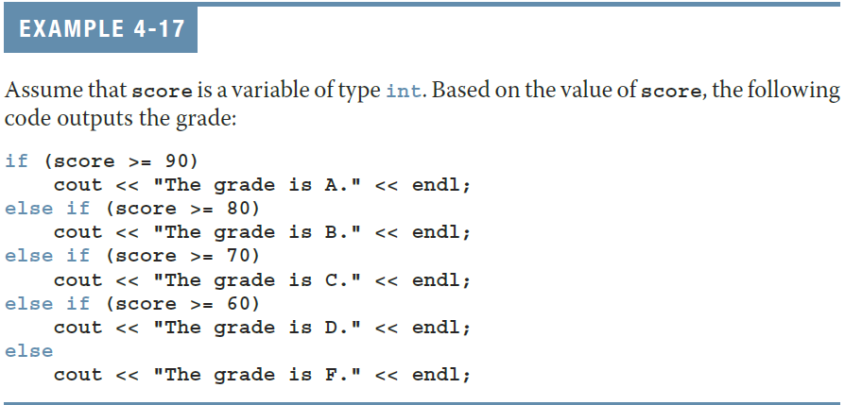
Multiple Selections: Nested if (2 of 2)

Slide 34
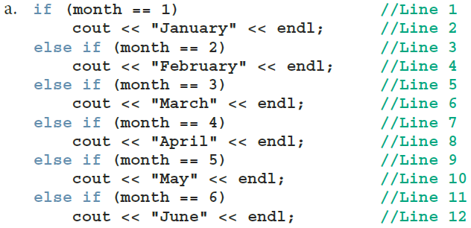
Comparing if…else Statements with a Series of if Statements (1 of 1)

Slide 35
Exercise
Display the grade point for the following statements in C++ program. The program should allow user to enter the grade in capital letter then, system display the following output.
Grade | Grade Point
A | 4.00 Distinction
B | 3.00 Credit
C | 2.50 Pass
D | 1.00 Fail
F | 0.00 No Grade
None of these grade | Invalid

Slide 36
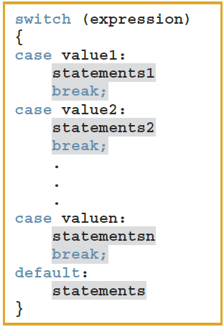
switch Structures (1 of 4)
switch structure is an alternate
to if-else
switch (integral) expression is evaluated first
Value of the expression determines which corresponding action is taken
Expression is sometimes called the selector

Slide 37
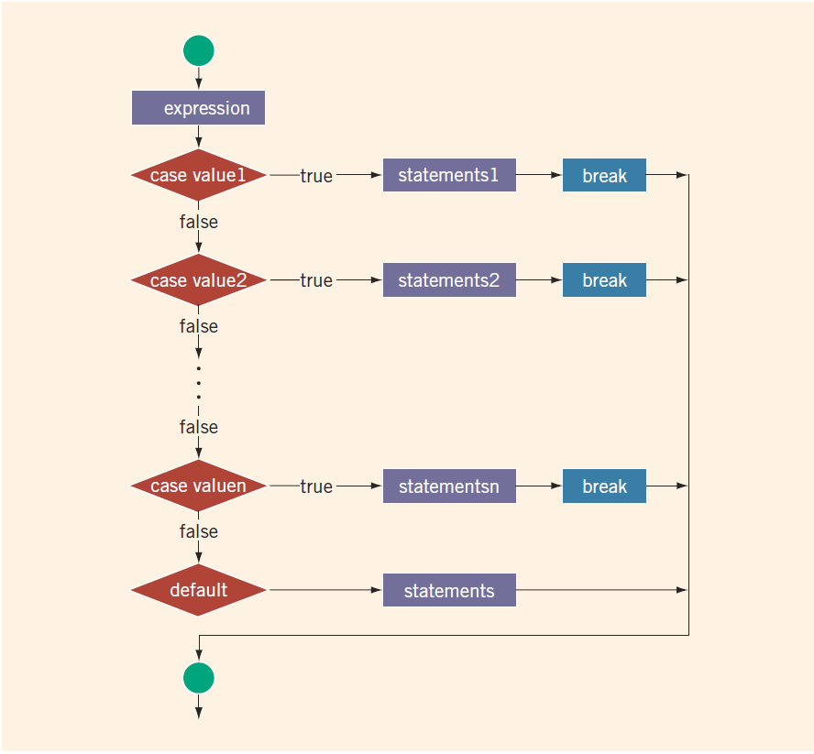
switch Structures (2 of 4)
FIGURE 4-4 switch statement

Slide 38
switch Structures (3 of 4)
One or more statements may follow a case label
Braces are not needed to turn multiple statements into a single compound statement
When a case value is matched, all statements after it execute until a break is encountered
The break statement may or may not appear after each statement
switch, case, break, and default are reserved words

Slide 39
Exercise
Display the grade point for the following statements in C++ program. The program should allow user to enter the grade in capital letter then, system display the following output.
Grade | Grade Point
A | 4.00 Distinction
B | 3.00 Credit
C | 2.50 Pass
D | 1.00 Fail
F | 0.00 No Grade
None of these grade | Invalid

Slide 40
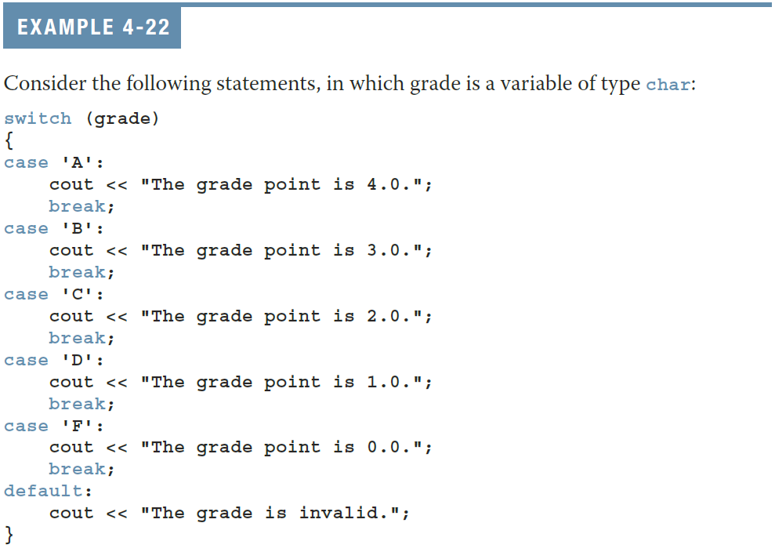
switch Structures (4 of 4)

Slide 41
Quick Review (1 of 3)
Control structures alter normal control flow
Most common control structures are selection and repetition
Relational operators: ==, <, <=, >, >=, !=
Logical expressions evaluate to 1 (true) or 0 (false)
Logical operators: ! (not), && (and), || (or)

Slide 42
Quick Review (2 of 3)
Two selection structures are one-way selection and two-way selection
The expression in an if or if...else structure is usually a logical expression
No stand-alone else statement exists in C++
  Every else has a related if
A sequence of statements enclosed between braces, { and }, is called a compound statement or a block of statements

Slide 43
Quick Review (3 of 3)
Using assignment in place of the equality operator creates a semantic error
The execution of a switch structure handles multiway selection
The execution of a break statement ends a switch statement

